Slide 1
Croyez ceux qui cherchent la vérité, doutez de ceux qui la trouvent.
Doutez de tout, mais ne doutez pas de vous-mêmes.
André Gide

Slide 2
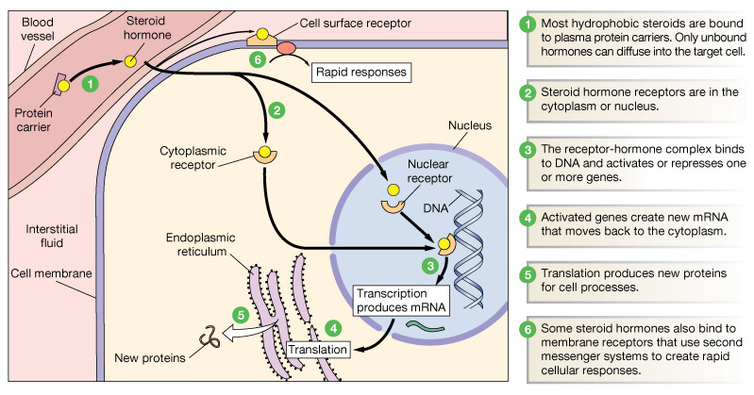
Steroid Hormones: Structure and Action
Nuclear Hormone Receptors

Slide 3
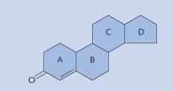
Basic Structure of a steroid hormone
-Small
-Lipophilic
-Circulate bound to plasma proteins
-diffuse across plasma membrane
-inside the cell: bind to highly specific, soluble receptor proteins
-cytoplasmic or nuclear receptors
-activate DNA for protein synthesis
-slower acting, longer half-life

Slide 4
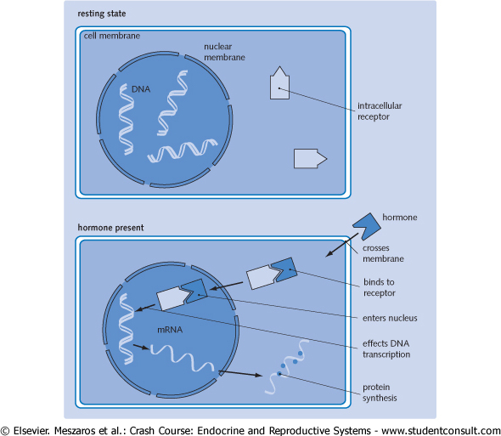
Mechanism of action of an intracellular receptor

Slide 5
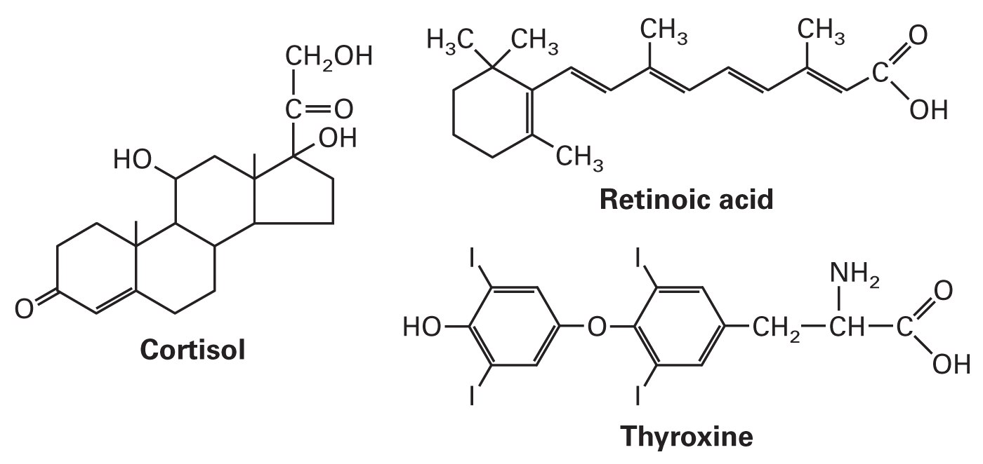
Nuclear Hormone Receptors
48 encoded in the human genome
250 in c. elegans, 21 in drosophila, 0 in yeast
are receptors for a wide range of hydrophobic molecules:

Slide 6
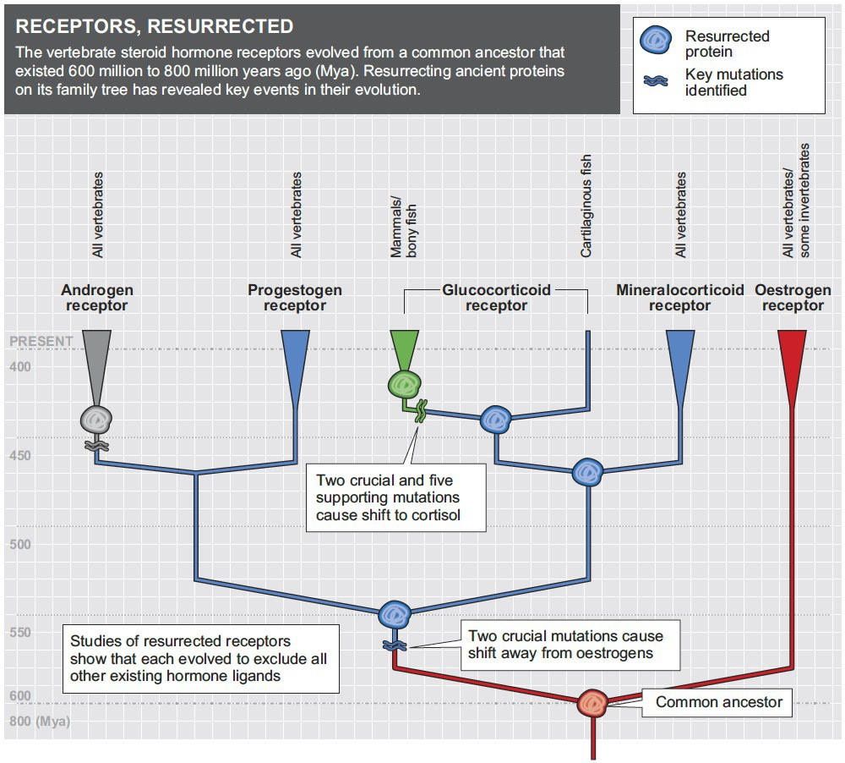

Slide 7
Mode of action
upon binding of the signaling molecule, the ligand, receptor complex binds to specific DNA sequences as dimer:
ERE: 5’-AGGTCANNNTGACCT-3’
ERE=estrogen response elements

Slide 8
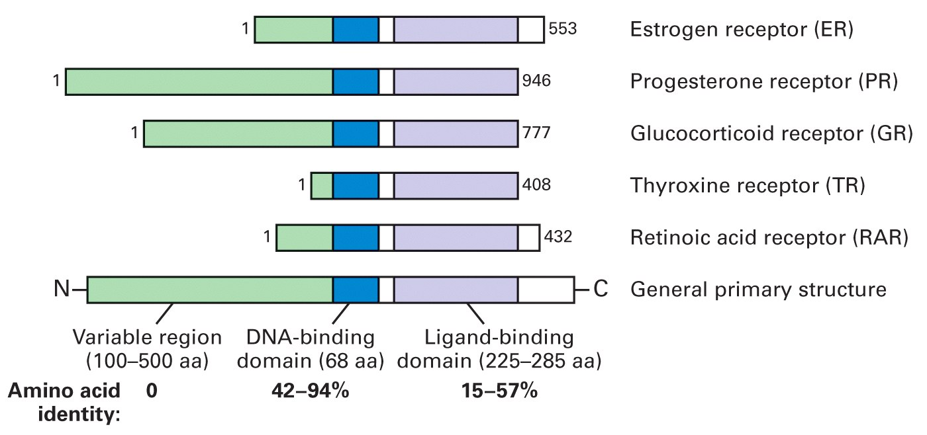
Domain structure of transcription factors in nuclear receptor superfamily
The hormone binding domain contains a hormone-dependent activation domain.
In some nuclear receptors, the hormone-binding domain functions as a repression domain in the absence of the ligand
Dimerization interfaces are located in mid- and C-terminal regions

Slide 9
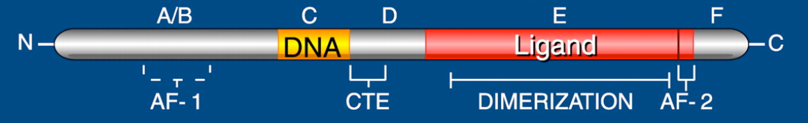
The modular structure of nuclear receptors

Slide 10
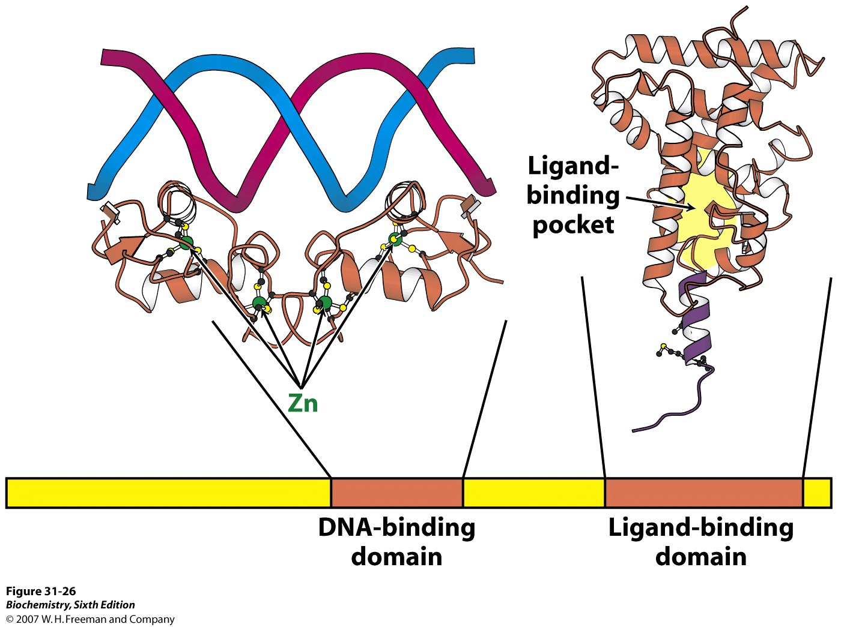
2 conserved domains:
DNA binding: 2 zinc finger motifs for binding to specific DNA sequences
via an α-helix that lies in the major groove

Slide 11
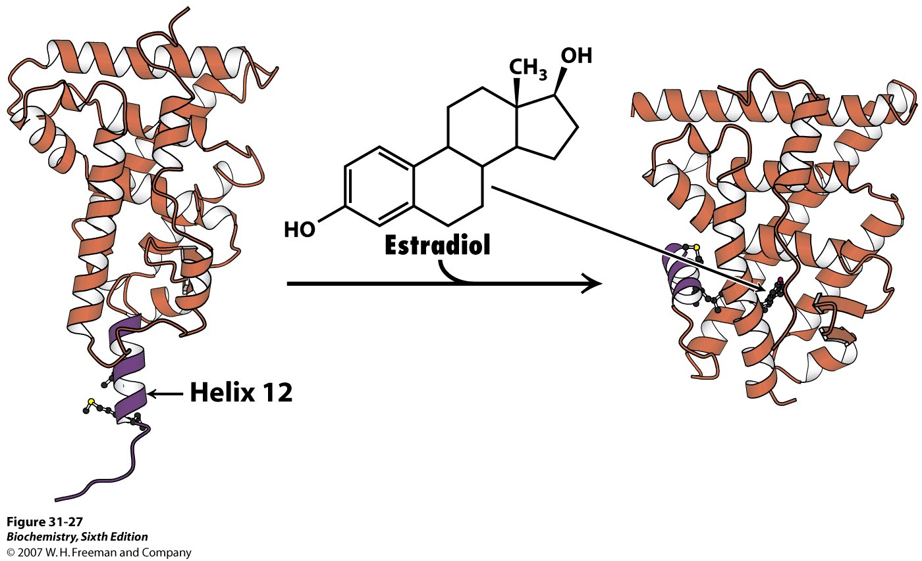
Ligand binding domain:
array of α-helices arranged in 3 layers
ligand binds hydrophobic pocket at the center
helix 12 folds into a groove upon ligand binding

Slide 12
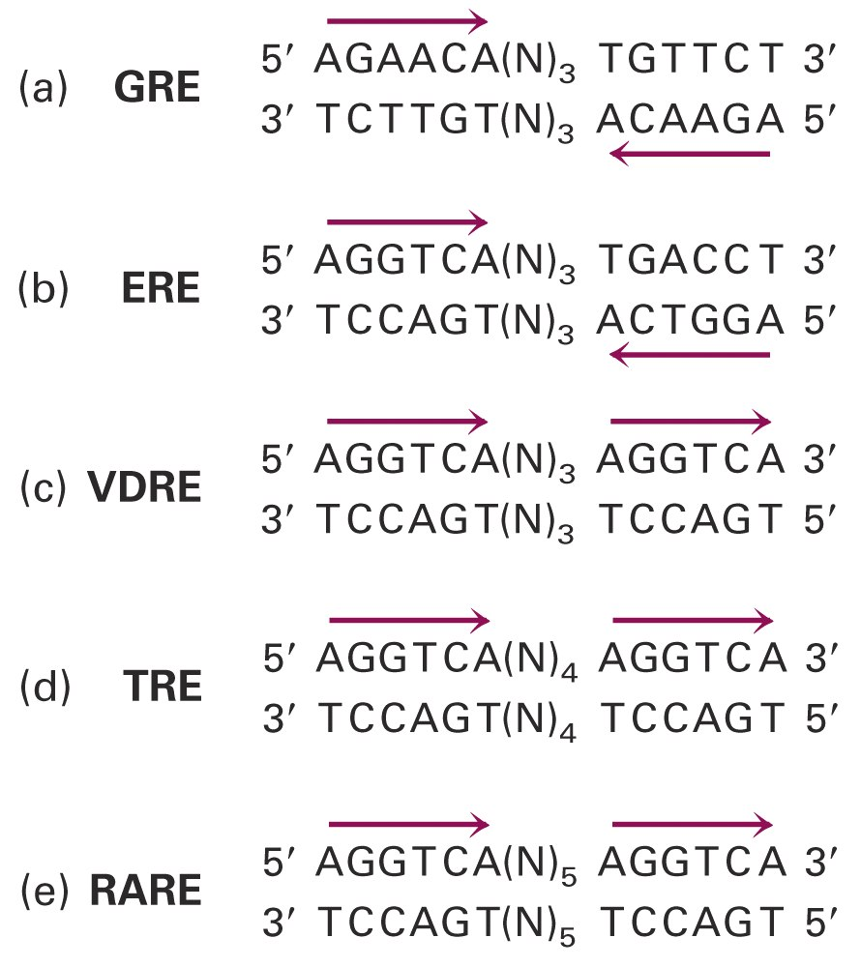
Nuclear-Receptor Response Elements
Homodimers
Specificity dictated by spacing
heterodimers with RXR

Slide 13
Nuclear receptor family
Palindrome HREs direct repeat HREs half-site HREs
ACGGTCA-N1-5-ACGGTCA AAA-ACGGTCA
TCA-AGGTCA
GRE/PRE AGAACA-N3-TGTTCT
ERE AGGTCA-N3-TGACCT

Slide 14
Type II: Heterodimeric nuclear receptors
Type I: Homodimeric nuclear receptors
Progesterone, mineralocorticoid, androgen and estrogen receptors
are in the cytoplasm or nucleus
associated with heat shock proteins in the absence of ligand
hormone binding leads to translocation to the nucleus
bind as homodimers to inverted repeats
RXR-VDR, RXR-TR, RXR-RAR
only in the nucleus
repress transcription when bound to DNA in the absence of ligand

Slide 15
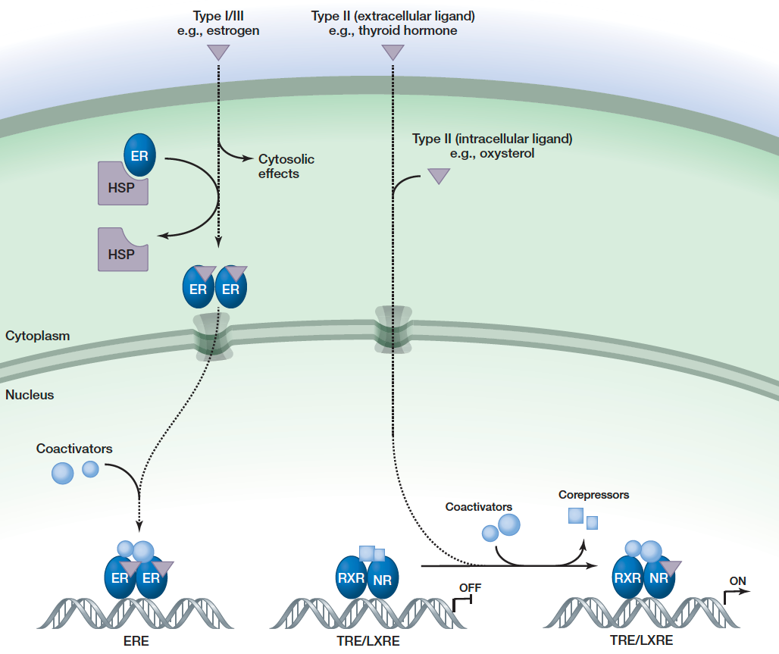

Slide 16
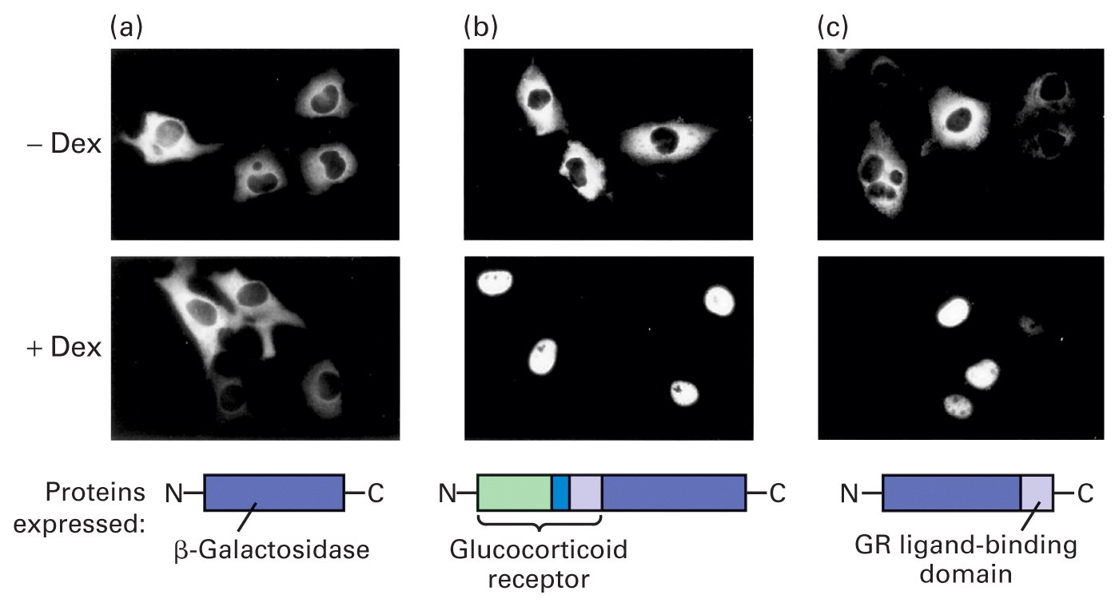
Didier Picard, Keith Yamamoto (1987) EMBO J

Slide 17
Combinatorial control
few eukaryotic TFs have any effect on transcription on their own
each factor recruits other proteins to build up large complexes that interact with the transcriptional machinery to activate transcription
advantage: a given regulatory protein can have different effects depending on what other proteins are present in the same cell

Slide 18
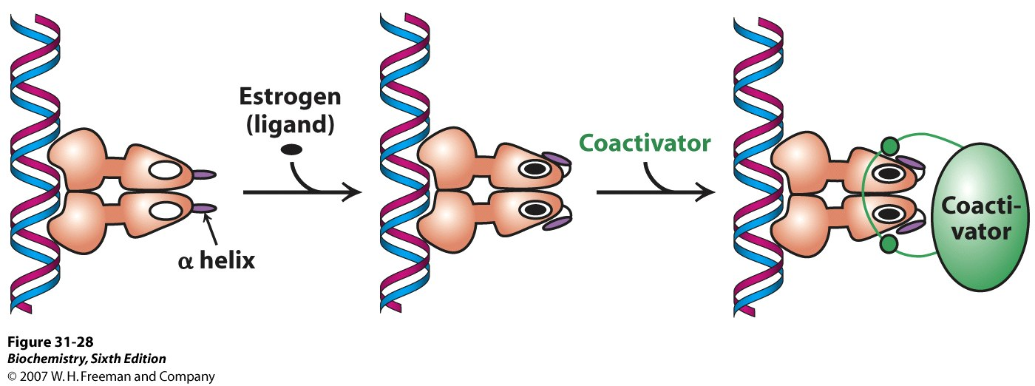

Slide 19
Coactivators
P160 family
Steroid receptor coactivator-1 (SRC-1)
Glucocorticoid receptor interacting protein-1 (GRIP-1)
Nuclear hormone receptor coactivator-1 (NcoA-1)
in many cases they possess enzymatic activity resulting in modification of chromatin structure

Slide 20
How do coactivators modulate transcriptional activity?
they loosen the histone complexes from the DNA, exposing additional DNA regions to the transcription machinery
covalent modifications of amino terminal tails of histones
acetylation: histone acetyl transferases (HAT)
other functions of coregulators
methylases CARM-1, PRMT-1
RNA transcription
cell cycle regulators cdc-25b
RNA helicases
docking to basal transcription factors

Slide 21
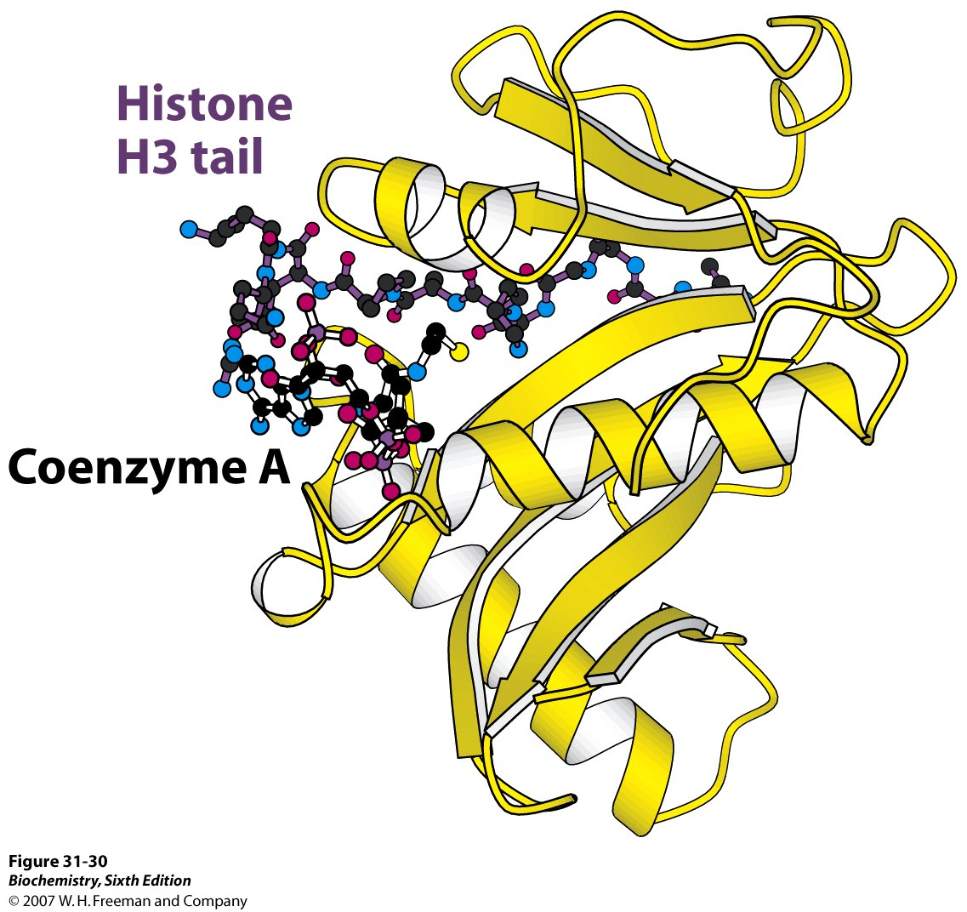

Slide 22
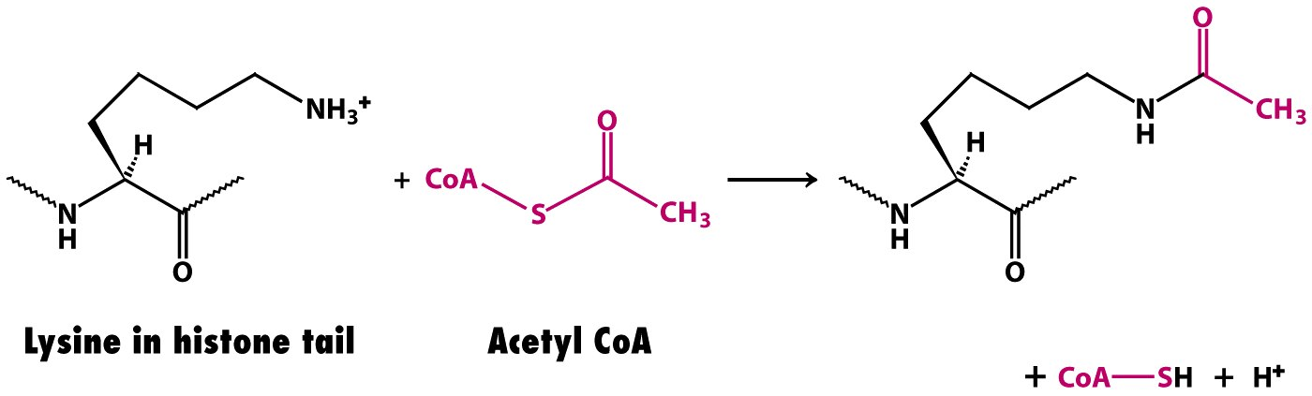
Histone acetylation
histone acetyltransferase (HAT)
lysine has positively charged ammonium group (at neutral pH)
addition of acetyl group generates an uncharged amide group
affinity for DNA is dramatically decreased
histone-DNA complex loosens

Slide 23
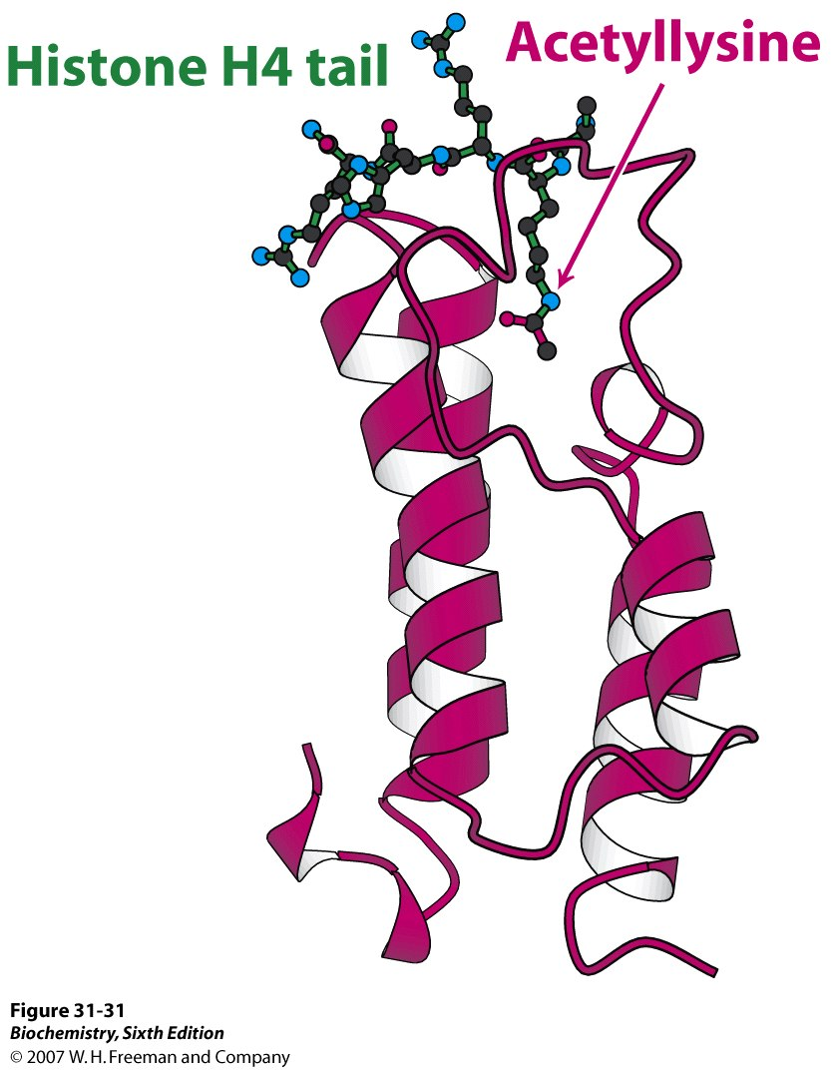
Structure of a bromodomain

Slide 24
Bromodomain
acetylated lysine residues interact with acetyl lysine-binding domain (bromodomain)
present in many proteins that regulate eukaryotic transcription
comprises about 110 amino acids that form a 4-helix bundle containing a peptide-binding site at one end
via the bromodomain acetylated lysine residues recruit transcriptional machinery
present in some components of chromatin remodeling engines, that contain domains homologous to helicases and utilize the free energy of ATP hydrolysis to shift the positions of nucleosomes along the DNA, this leads to changes in DNA structure

Slide 25
Histone acetylation
activates transcription by
1. reducing affinity of histones for DNA
2. recruiting other components of the transcriptional machinery
3. initiating the remodelling of the chromatin structure

Slide 26
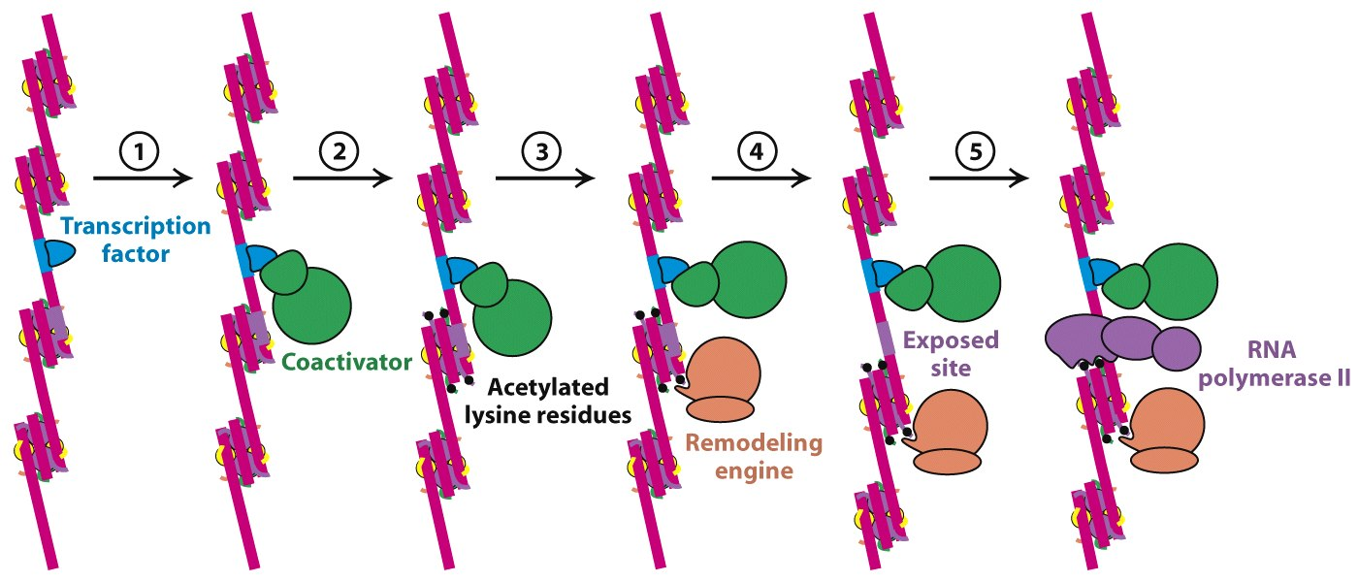

Slide 27
1. phosphorylation: threonine, serine or tyrosine
2. acetylation: lysine
3. methylation: lysine, arginine

Slide 28
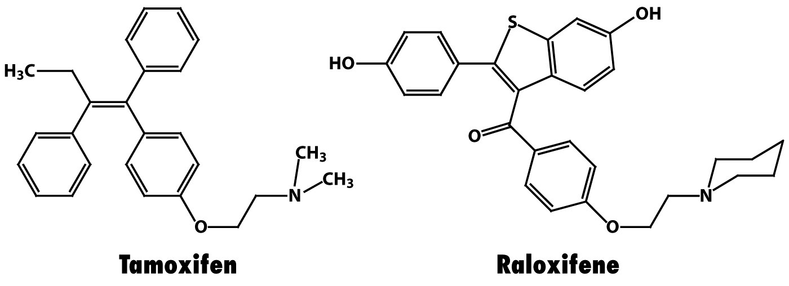
ERα antagonists selective estrogen receptor modulators (SERMs)

Slide 29
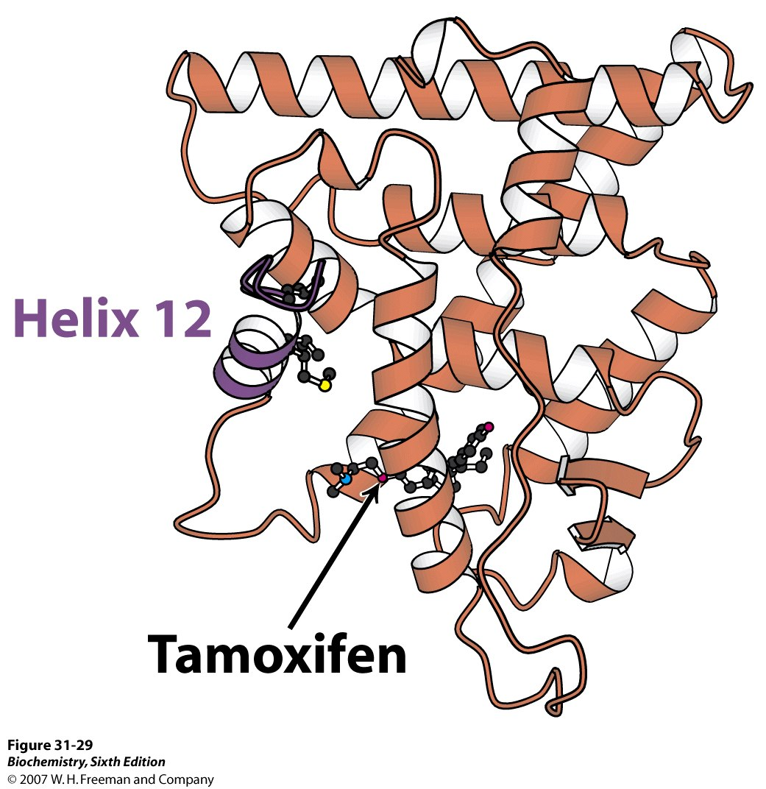
Tamoxifen binds in the
pocket normally occupied
by estrogen.
Part of the tamoxifen
structure extends from
the pocket.
Helix 12 cannot pack in
its usual position.
Coactivator binding is blocked.

Slide 30
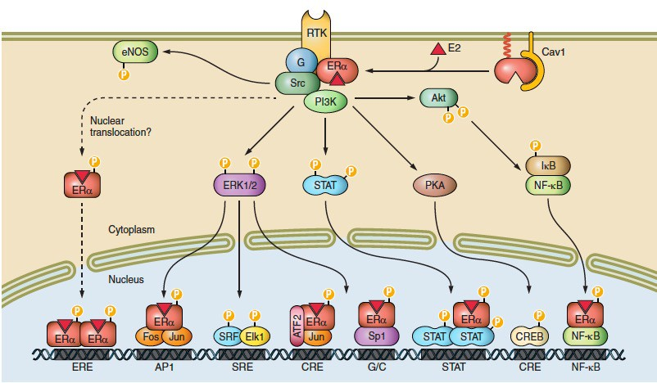
Membrane ER Signaling Pathway (MISS)
Lipidation of ER at the palmitoylation site Cys 447
Physiol Rev • VOL 97 • JULY 2017

Slide 31
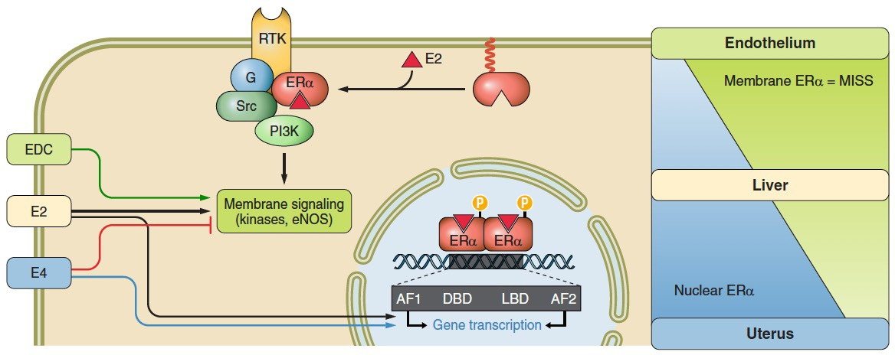
Tissue-specific actions of Selective Estrogen Receptor Modulators (SERMs)
Estrogen dendrimer conjugate (EDC)
Estradiol (E2)
Estetrol (E4)
Physiol Rev • VOL 97 • JULY 2017

